Slide 1
Insight Moonbase
Design, 2D diagrams - Kent Nebergall
3D Models – Aarya Singh

Slide 2
Outpost Habitat

Slide 3
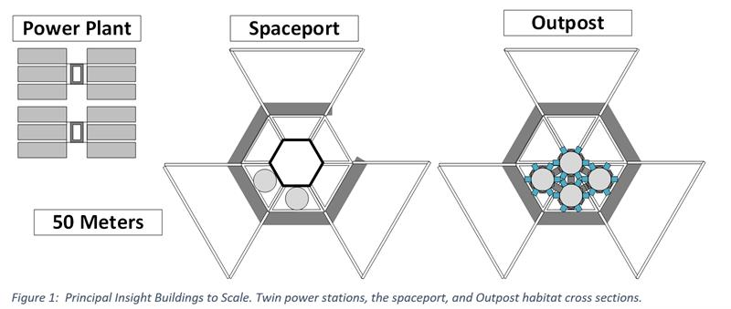

Slide 4
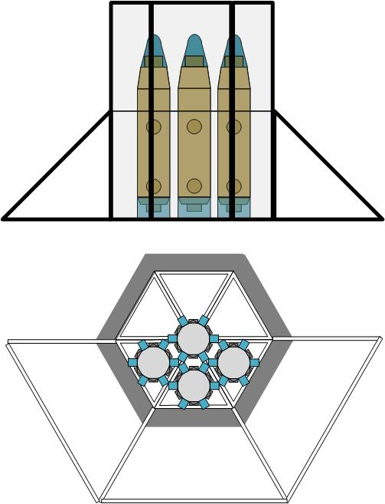

Slide 5
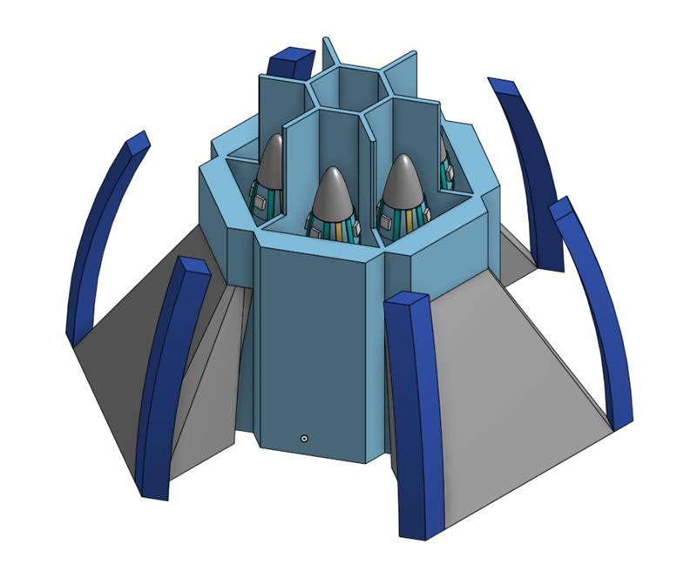

Slide 6
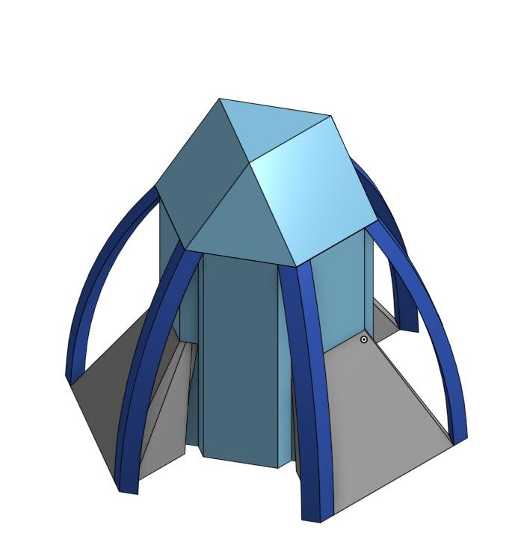

Slide 7
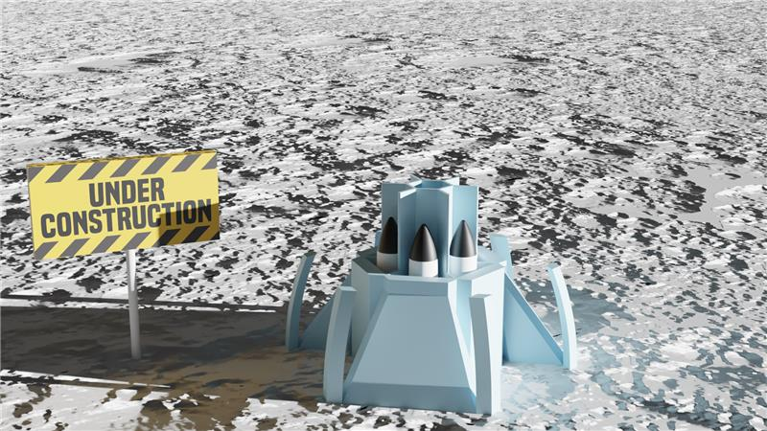
Notes:
When he sent this, after waiting until almost the deadline, I asked – “How old are you again?” He’d just turned 15 a couple days ago. So not super-professional to have the sign, but left it as playful note. Can always crop it.

Slide 8
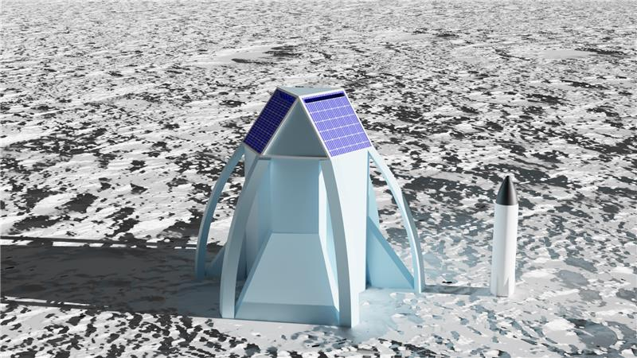
Notes:
Solar panel texture added. Put short border around edge of triangle to keep from getting lost in shadow. Solar panel isn’t really a design part – it’s just to keep the shaded side of the roof vertexes from being lost when printed. A fiber optic light collector like this wouldn’t actually be a bad idea.

Slide 9
Insight Spaceport

Slide 10
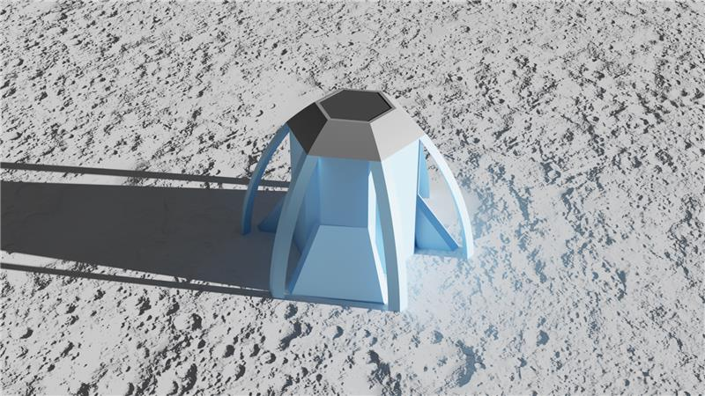

Slide 11
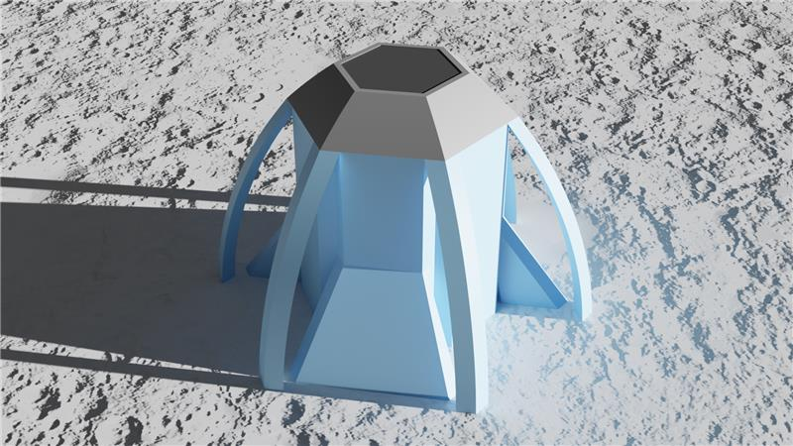

Slide 12
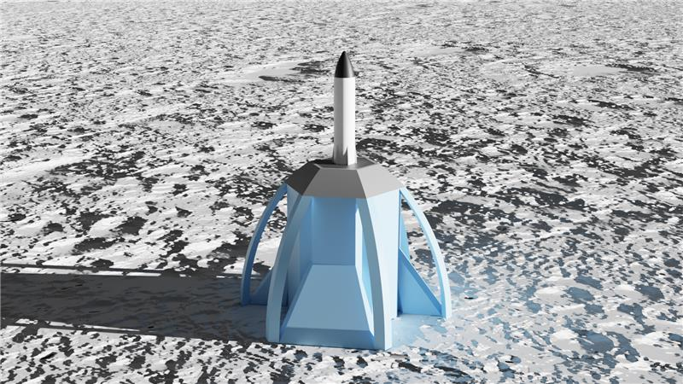

Slide 13
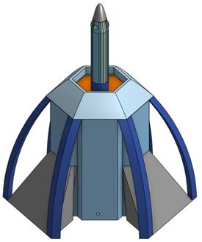

Slide 14
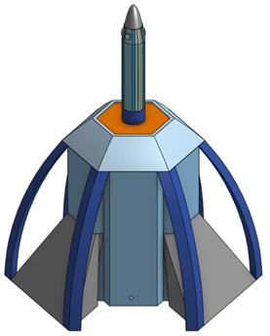

Slide 15
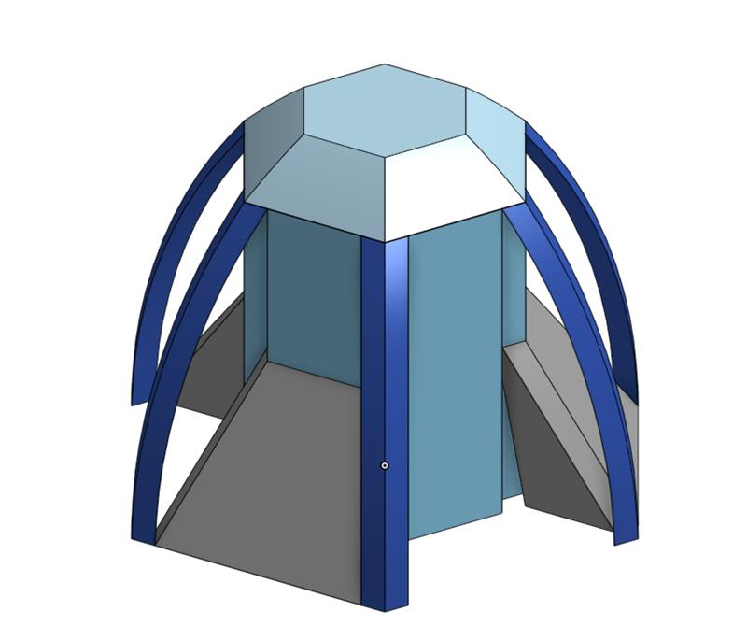

Slide 16
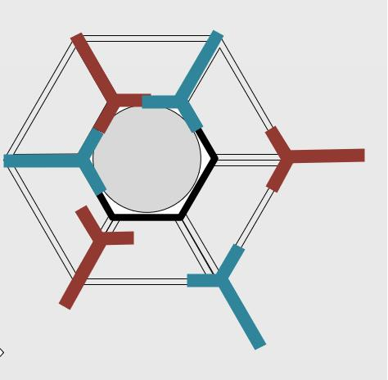
Notes:
Landing Platform Arm Sketch – arms would re-center and lift vehicle for launch. Y shape would let the lift load be transferred to the other arms rather than crushing the ship.

